Slide 1

Asynchronous Programming and Promises
Promises. Async / Await.
SoftUni Team
Technical Trainers
Software University
http://softuni.bg

Slide 2
Table of Contents
Asynchronous Programming
Promises
Async / Await

Slide 3
Have a Question?
sli.do #JS-CORE

Slide 4

Asynchronous Programming
Synchronous vs Asynchronous

Slide 5
Asynchronous Programming
Not the same thing as concurrent or multi-threaded
There can be asynchronous code, but it is generally single-threaded
Needs to be structured using callback functions
In current versions of JS there are also:
Promises
Async / Await pattern

Slide 6
Asynchronous Programming
Runs several tasks (pieces of code) in parallel
Synchronous
Asynchronous
Number of tasks
Number of tasks
1
1
20 seconds
20 seconds
2
2
7 seconds
7 seconds
3
3
10 seconds
10 seconds
4
4
8 seconds
8 seconds

Slide 7
Asynchronous Programming - Example
The following commands will be executed as follows:
console.log("Hello.");
// Hello.
setTimeout(function() {
console.log("Goodbye!");
}, 2000);
// Hello again!
// Goodbye!
console.log("Hello again!");

Slide 8
Asynchronous Programming
Synchronous programming
Each line of code is executed only when the preceding line has finished it’s work
Asynchronous Programming
In asynchronous programs, you can have two lines of code (L1 followed by L2), where L1 schedules some task to be run in the future, but L2 runs before that task completes
The tasks may finish in order of execution but it is not guaranteed

Slide 9
Asynchronous Programming in JS
Asynchronous does not mean the same thing as concurrent or multi-threaded
JavaScript can have asynchronous code, but it is generally single-threaded (except when using Web Workers)
Asynchronous code needs to be structured in a different way than synchronous code, and the most basic way to do that is with callback functions
In current versions of JavaScript we have two more options
Promises
Async / Await patern

Slide 10
Do we need asynchronous programming in JS?
Some people decide that dealing with asynchronous code is too complicated to work with, so they try to make everything synchronous
When doing an AJAX call, it is possible to set an option to make the call synchronous rather than asynchronous (although this option is slowly losing browser support)
There are also synchronous alternatives to many asynchronous functions in Node.js

Slide 11
Do we need asynchronous programming in JS?
Trying to avoid asynchronous code and replacing it with synchronous code is almost always a bad idea in JavaScript
JavaScript only has a single thread (except when using Web Workers)
The webpage will be unresponsive while the script is running. If you use a synchronous AJAX call, then the user will not be able to do anything while they are running
The issue is even worse when using server-side JavaScript: the server will not be able to respond to any requests while waiting for synchronous functions to complete, which means that every user making a request to the server will have to wait to get a response

Slide 12
.then()
.catch()
Promises
Objects Holding Asynchronous Operations

Slide 13
What is a Promise?
An object holding an asynchronous operation
States:
Pending - operation still running (unfinished)
Fulfilled - operation finished (the result is available)
Failed - operation failed (an error is available)
Promises use the Promise object
new Promise(executor);

Slide 14
What is a Promise?
returns
returns
…
Promise
Promise
then
then
resolve
onFulfilled
return data
resolve
onFulfilled
reject
onRejected
throw error
reject
onRejected

Slide 15
Promise Methods
Promise.reject(reason)
Returns an object that is rejected with the given reason
Promise.resolve(value)
Returns an object that is resolved with the given value
Promise.all(iterable)
Returns a promise that either fulfills when all of the promises have fulfilled or rejects as soon as one of them rejects

Slide 16
Promise.then() - Example
console.log('Before promise');
new Promise(function(resolve, reject) {
setTimeout(function() {
resolve('done');
}, 500);
})
.then(function(res) {
console.log('Then returned: ' + res);
});
// Before promise
Resolved after 500 ms
// After promise
// Then returned: done
console.log('After promise');

Slide 17
Promise.catch() - Example
console.log('Before promise');
new Promise(function(resolve, reject) {
setTimeout(function() {
reject('fail');
}, 500);
})
.then(function(result) { console.log(result); });
.catch(function(error) { console.log(error); });
// Before promise
// After promise
Rejected after 500 ms
// fail
console.log('After promise');

Slide 18
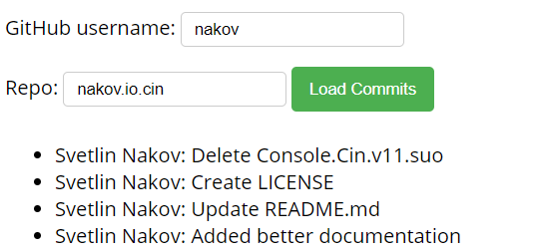
Problem: Load GitHub Commits
GitHub username:
<input type="text" id="username" value="nakov" /> <br>
Repo: <input type="text" id="repo" value="nakov.io.cin" />
<button onclick="loadCommits()">Load Commits</button>
<ul id="commits"></ul>
<script>
function loadCommits() {
// Use Fetch API
}
</script>
.then()
.catch()

Slide 19
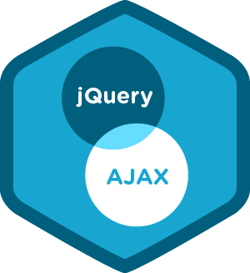
Promises with jQuery AJAX

Slide 20
jQuery Promise
The Deferred object is a chainable utility object.
Can register multiple callbacks into callback queues
Invoke callback queues and relay the success or failure state of a function
Is thenable - can be casted to native Promise
Some of the arguments passed to then() method will be discarded

Slide 21
jQuery Promise
The Deferred object, introduced in jQuery 1.5, is a chainable utility object created by calling the jQuery.Deferred() method. It can register multiple callbacks into callback queues, invoke callback queues, and relay the success or failure state of any synchronous or asynchronous function
jQuery 3.0 and newer Deferred object is a Promises/A+ implementation
Deferred object is thanable, so can be casted to native JS Promise, but some of the arguments passed to than() method will be discarded

Slide 22
jQuery Promise interface
As of jQuery 1.5, all of jQuery's Ajax methods return a superset of the XMLHTTPRequest object. This jQuery XHR object, or "jqXHR“, implements the Promise interface.
jqXHR.done(function( data, textStatus, jqXHR ) {});
An alternative construct to the success callback option
jqXHR.fail(function( jqXHR, textStatus, errorThrown ) {});
An alternative construct to the error callback option, the .fail() method replaces the deprecated .error() method
jqXHR.always(function( data|jqXHR, textStatus, jqXHR|errorThrown ) { }); (added in jQuery 1.6)
An alternative construct to the complete callback option, the .always() method replaces the deprecated .complete() method.
In response to a successful request, the function's arguments are the same as those of .done(): data, textStatus, and the jqXHR object For failed requests the arguments are the same as those of .fail(): the jqXHR object, textStatus, and errorThrown
jqXHR.then(function( data, textStatus, jqXHR ) {}, function( jqXHR, textStatus, errorThrown ) {});
Incorporates the functionality of the .done() and .fail() methods, allowing (as of jQuery 1.8) the underlying Promise to be manipulated

Slide 23
Problem: Load GitHub Commits with AJAX
GitHub username:
<input type="text" id="username" value="nakov" /> <br>
Repo: <input type="text" id="repo" value="nakov.io.cin" />
<button onclick="loadCommits()">Load Commits</button>
<ul id="commits"></ul>
<script>
function loadCommits() {
// AJAX call …
}
</script>

Slide 24
Solution: Load GitHub Commits with AJAX
function loadCommits() {
$("#commits").empty();
let url = "https://api.github.com/repos/" +
$("#username").val() + "/" +
$("#repo").val() + "/commits";
$.get(url)
.then(displayCommits)
.catch(displayError);
function displayCommits(commits) { … }
function displayError(err) { … }
}
jQuery AJAX methods return promises

Slide 25
Solution: Load GitHub Commits with AJAX (2)
function displayCommits(commits) {
for (let commit of commits)
$("#commits").append($("<li>").text(
commit.commit.author.name + ": " +
commit.commit.message
));
}
function displayError(err) {
$("#commits").append($("<li>").text("Error: " +
err.status + ' (' + err.statusText + ')'));
}
Check your solution here: https://judge.softuni.bg/Contests/1570

Slide 26
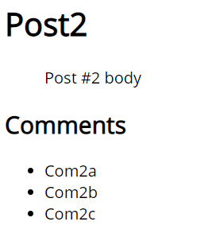
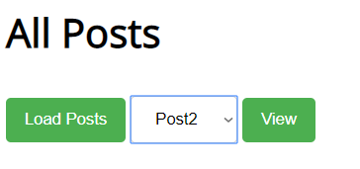
Problem: Blog
Create a Kinvey app and then add user "peter" with password "p"
Create comments "Com1a" and "Com1b" for "Post1
Create comments "Com2a", "Com2b" and "Com2c" for "Post2“
Display all posts and view the selected post along with its comments

Slide 27
Solution: Blog - Create First Post
Insert your Kinvey App ID here
POST /appdata/kid_S1htVfcmm/posts/ HTTP/1.1
Host: baas.kinvey.com
Authorization: Basic cGV0ZXI6cA==
Content-Type: application/json
{ "title":"Post1", "body":"Post #1 body" }
Base64(user:pass)
{ "title": "Post3", "body": "Post #3 body", …,
"_id": "5c9a3e3b13ebac4e57c0451e" }
Remember the post _id

Slide 28
Solution: Blog - Create Comments
POST /appdata/kid_S1htVfcmm/comments/ HTTP/1.1
Host: baas.kinvey.com
Authorization: Basic cGV0ZXI6cA==
Content-Type: application/json
{ "text":"Com1a", "post_id":"5c9a3e3b13ebac4e57c0451e" }
Use post _id from the previous request
POST /appdata/kid_S1htVfcmm/comments/ HTTP/1.1
Host: baas.kinvey.com
Authorization: Basic cGV0ZXI6cA==
Content-Type: application/json
{ "text":"Com2a", "post_id":"5c9a3e3b13ebac4e57c0451e" }

Slide 29
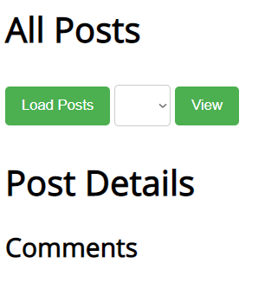
Solution: Blog - HTML Code
<script src="jquery-3.1.1.min.js"></script>
<script src="blog.js"></script>
<h1>All Posts</h1>
<button id="btnLoadPosts">Load</button>
<select id="posts"></select>
<button id="btnViewPost">View</button>
<h1 id="post-title">Post Details</h1>
<ul id="post-body"></ul>
<h2>Comments</h2>
<ul id="post-comments"></ul>

Slide 30
Solution: Blog - JS Code
$(document).ready(function() {
const kinveyAppId = "kid_S1htVfcmm";
const serviceUrl = "https://baas.kinvey.com/appdata/" +
kinveyAppId;
const kinveyUsername = "peter";
const kinveyPassword = "p";
const base64auth = btoa(kinveyUsername + ":" +
kinveyPassword);
const authHeaders = { "Authorization": "Basic " + base64auth };
$("#btnLoadPosts").click(loadPostsClick);
$("#btnViewPost").click(viewPostClick);
function loadPostsClick() { … }
function viewPostClick() { … }
…
});

Slide 31

Solution: Blog - Load Posts
function loadPostsClick() {
let loadPostsRequest = {
url: serviceUrl + "/posts",
headers: authHeaders,
};
$.ajax(loadPostsRequest)
.then(displayPosts)
.catch(displayError);
}

Slide 32
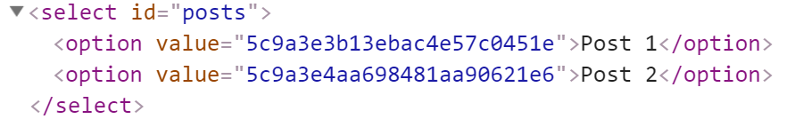
Solution: Blog - Display Posts as Options
function displayPosts(posts) {
$("#posts").empty();
for (let post of posts) {
let option = $("<option>")
.text(post.title)
.val(post._id);
$("#posts").append(option);
}
}

Slide 33
Solution: Blog - Handle AJAX Errors
function displayError(err) {
let errorDiv = $("<div>").text("Error: " +
err.status + ' (' + err.statusText + ')');
$(document.body).prepend(errorDiv);
setTimeout(function() {
$(errorDiv).fadeOut(function() {
$(errorDiv).remove();
});
}, 3000);
}

Slide 34
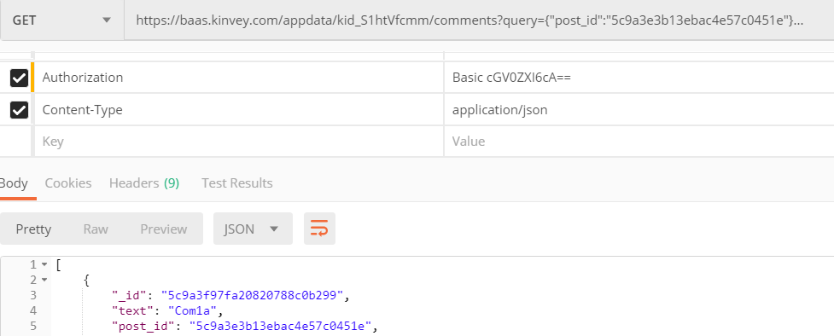
Solution: Blog - Load Post Comments Query
Kinvey allows querying collections:
https://baas.kinvey.com/appdata/kid_S1htVfcmm/comments ?query={"post_id":"5c9a3e3b13ebac4e57c0451e"}

Slide 35
Solution: Blog - [View Post] Button Click
function viewPostClick() {
let selectedPostId = $("#posts").val();
if (!selectedPostId) return;
let requestPosts = $.ajax({
url: serviceUrl + "/posts/" + selectedPostId,
headers: authHeaders });
let requestComments = $.ajax({ url: serviceUrl + `/comments/?query={"post_id":"${selectedPostId}"}`,
headers: authHeaders });
Promise.all([requestPosts, requestComments])
.then(displayPostWithComments)
.catch(displayError);
}

Slide 36
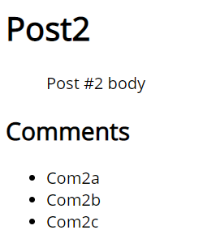
Solution: Blog - Display Post with its Comments
function displayPostWithComments([post, comments]) {
$("#post-title").text(post.title);
$("#post-body").text(post.body);
$("#post-comments").empty();
for (let comment of comments) {
let commentItem = $("<li>")
.text(comment.text);
$("#post-comments")
.append(commentItem);
}
}
Check your solution here: https://judge.softuni.bg/Contests/1570

Slide 37
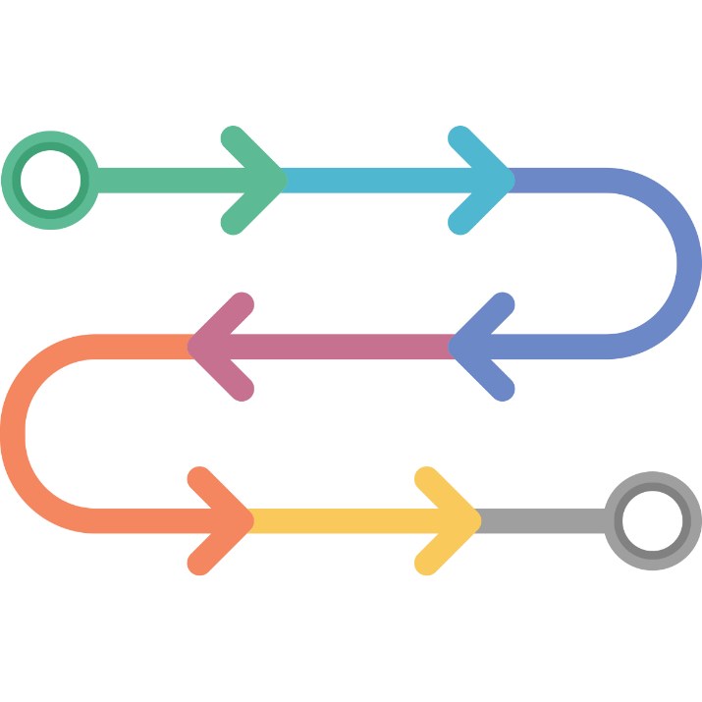
Async / Await
Simplified Promises

Slide 38
Async Functions
Operate asynchronously via the event loop
Contain an await expression that:
Is only valid inside async functions
Pauses the execution
Waits for the Promise's resolution
Async / Await is similar to combining generators and promises

Slide 39
Async Functions
The async function declaration defines an asynchronous function, which returns an AsyncFunction object
An asynchronous function is a function which operates asynchronously via the event loop, using an implicit Promise to return its result
The syntax and structure of your code using async functions is much more like using standard synchronous functions

Slide 40
Async Functions
An async function can contain an await expression that pauses the execution and waits for the passed Promise's resolution
After resolution the async function's execution resumes and resolved value is available
Тhe await keyword is only valid inside async functions
The purpose of async/await functions is to simplify the behavior of using promises synchronously
async/await is similar to combining generators and promises

Slide 41
Async Functions (2)
function resolveAfter2Seconds() {
return new Promise(resolve => {
setTimeout(() => {
resolve('resolved');
}, 2000);
});
}
Expected output:
// calling
// resolved
async function asyncCall() {
console.log('calling');
var result = await resolveAfter2Seconds();
console.log(result);
}

Slide 42
Async Functions (3)
Do not confuse await with Promise.then()
To await two or more promises in parallel, use Promise.then()
If a promise resolves normally, then await promise returns the result
In case of a rejection, it throws an error
async function f() { try {
let response = await fetch();
let user = await response.json();
} catch (err) {
// catches errors both in fetch and
response.json
alert(err);
}
}
async function f() {
let response = await fetch();
}
// f() becomes a rejected promise
f().catch(alert);

Slide 43
Sequential Execution
To execute different promise methods one by one, use Async /Await
function doJob(x,sec) {
return new Promise(resolve => {
console.log('Start: ' + x);
setTimeout(() => {
console.log('End: ' + x);
resolve(x);
}, sec *1000);
});
}
async function SerialFlow() {
let result1 = await doJob(1,1);
let result2 = await doJob(2,2);
let result3 = await doJob(3,3);
let finalResult = result1 + result2 + result3;
console.log(finalResult);
}
// Start: 1
// End: 1
// Start: 2
// End: 2
// Start: 3
// End: 3
// 6

Slide 44
Concurrent Execution
async function ParallelFlow() {
let result1 = doJob(1,1);
let result2 = doJob(2,2);
let result3 = doJob(3,3);
let finalResult = await result1 + await result2 +
await result3;
console.log(finalResult);
}
// Expected output:
// Start: 1
// Start: 2
// Start: 3
// End: 1
// End: 2
// End: 3
// 6

Slide 45
Problem: Blog
Write a program for reading blog content
It needs to make requests to the server
Display all blog posts and their comments
<h1>All Posts</h1>
<button id="btnLoadPosts">Load Posts</button>
<select id="posts"></select>
<button id="btnViewPost">View</button>
<h1 id="post-title">Post Details</h1>
<ul id="post-body"></ul>
<h2>Comments</h2>
<ul id="post-comments"></ul>
<script src="app.js"></script>

Slide 46
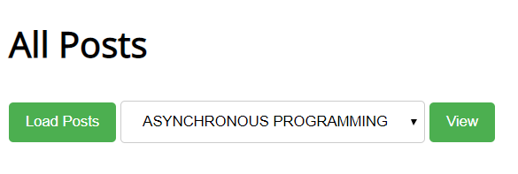
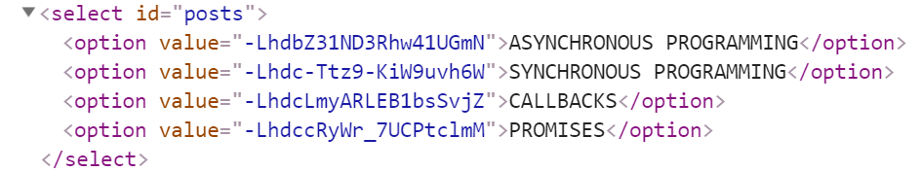
Problem: Blog - Example

Slide 47
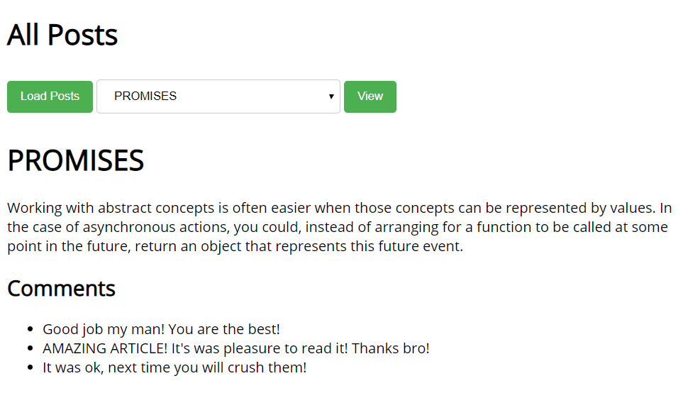
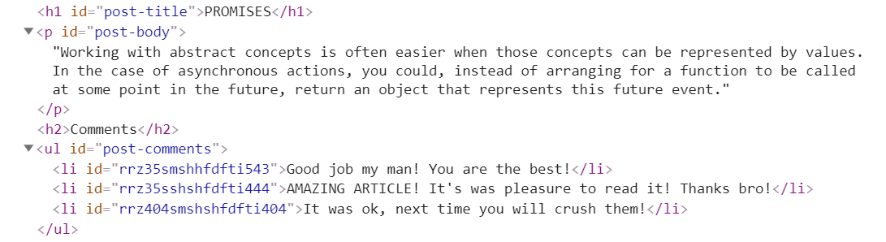
Problem: Blog - Example

Slide 48
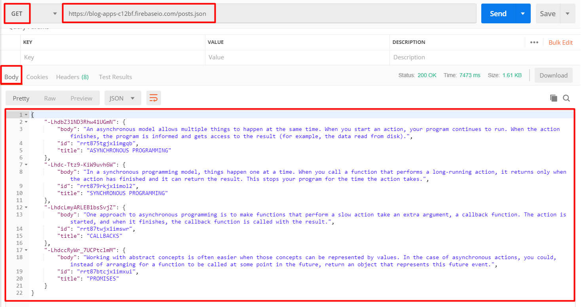
Problem: Blog - Get All Posts
https://blog-apps-c12bf.firebaseio.com/posts.json

Slide 49
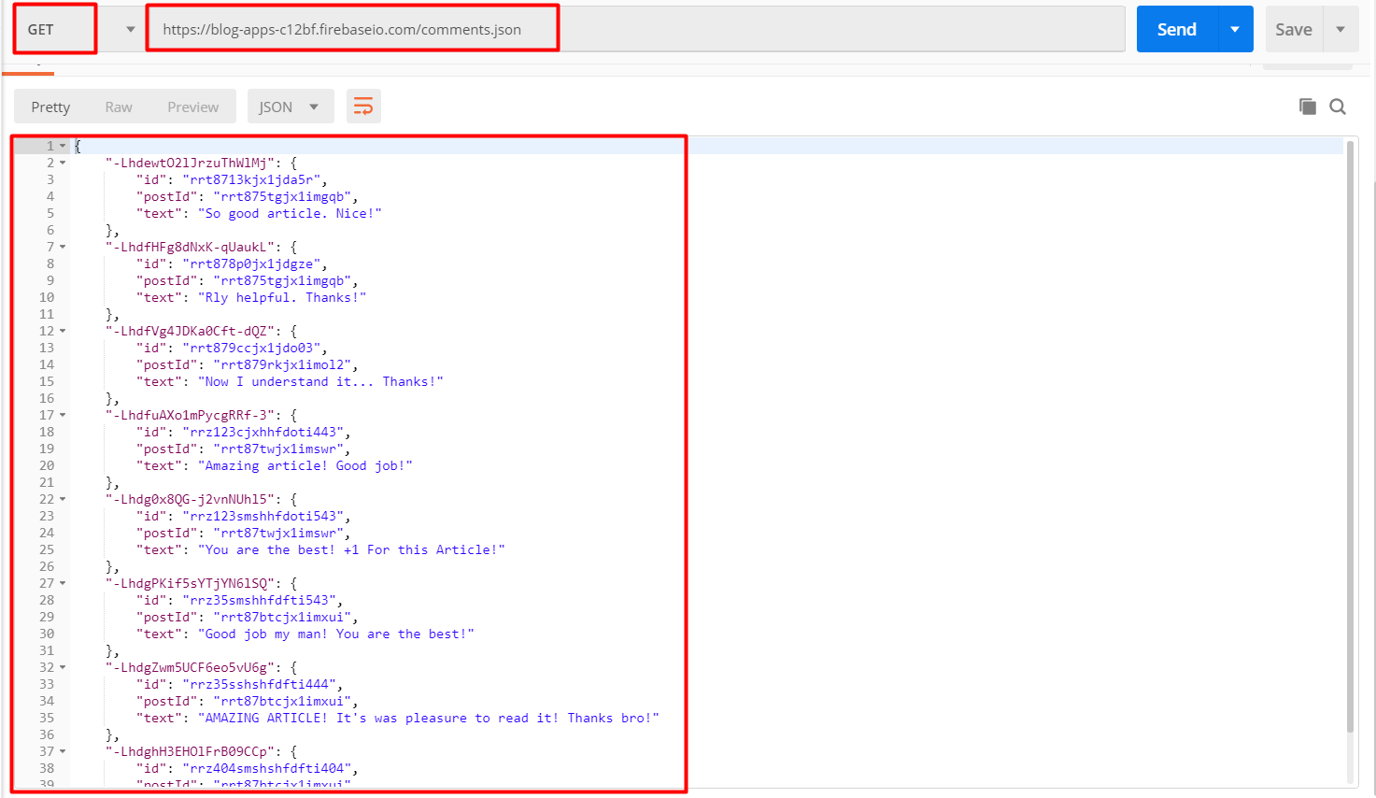
Problem: Blog - Get All Comments

Slide 50

Live Exercises

Slide 51

Summary
…
…
…
Asynchronous programming
Runs several tasks in parallel, at the same time
Promises hold operations
Can be resolved or rejected
Async functions contain an await expression. It:
Pauses the execution
Waits for the Promise's resolution

Slide 52
https://softuni.bg/courses/js-applications

Slide 53












SoftUni Diamond Partners

Slide 54




SoftUni Organizational Partners

Slide 55




Trainings @ Software University (SoftUni)
Software University – High-Quality Education and Employment Opportunities
softuni.bg
Software University Foundation
http://softuni.foundation/
Software University @ Facebook
facebook.com/SoftwareUniversity
Software University Forums
forum.softuni.bg

Slide 56

License
This course (slides, examples, demos, videos, homework, etc.) is licensed under the "Creative Commons Attribution-NonCommercial-ShareAlike 4.0 International" license

